Slide 1

Breaking away from the cacophony of news channels,
Bharat Express is launched with paramount ethos of journalism – Satya, Sahas and Samarpan!

Slide 2
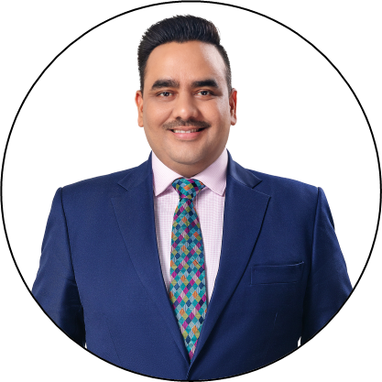
The Man with a Mission!
Professional Journey
  Mr Upendrra Rai leads the team of passionate and dedicated journalists & media professionals at Bharat Express
The Young & Dynamic Journalist is the CMD and Editor-in-Chief of Bharat Express. Formerly, he also held leadership role as CEO & Editor-in-Chief of Sahara News Network and Tehelka
1997
Started as Correspondent in Sahara News Network
2002
Joined Star News (now ABP News)
2004
Founding Member of CNBC Awaaz (Network18)
2005
Principal Correspondent at Star News (now ABP News)
2009
Editor & News Director, Sahara News Network
2016
CEO & Editor-in-Chief, Tehelka
2019
CEO & Editor-in-Chief, Sahara News Network
2023
Founded Bharat Express News Network as CMD & Editor-in-Chief

Slide 3
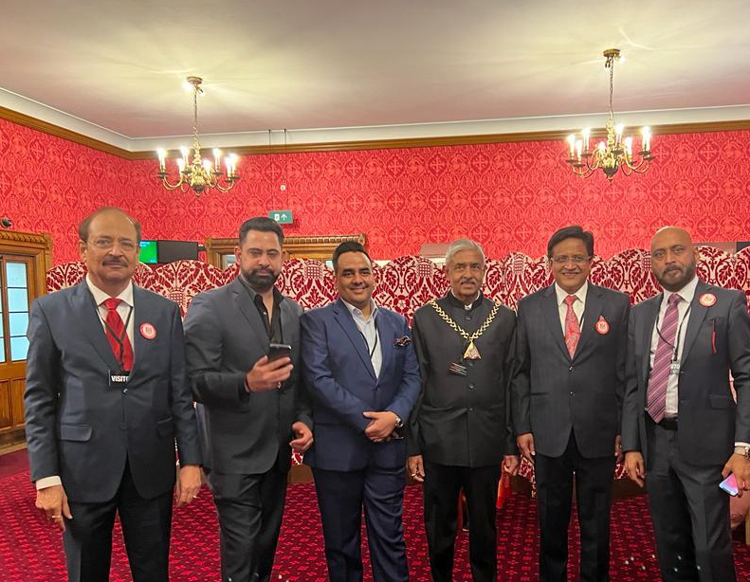
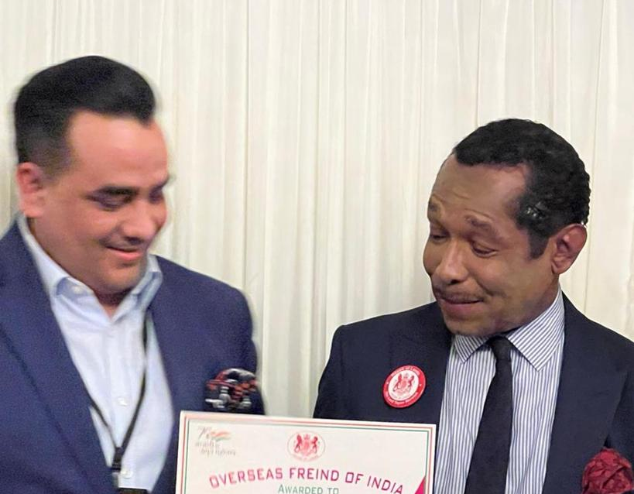
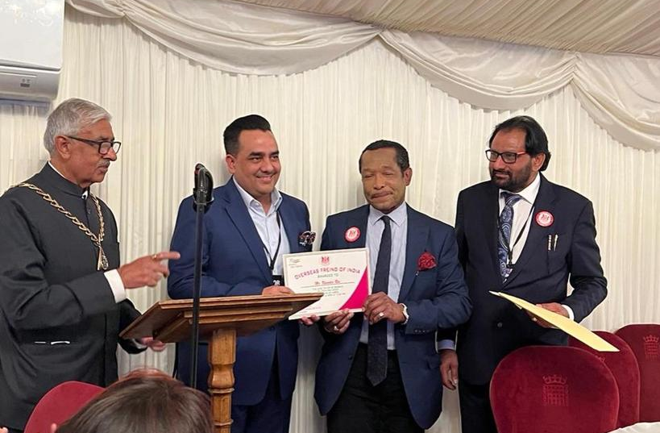
Awards & Accolades
Mr Upendrra Rai has been decorated with prestigious National & International Awards for his Ethical Journalism and Contribution in Media
Star Achiever Award in 2006
Star Patrakar Ratna Award in 2007
Indian Television Academy Awards for best reporting among Hindi news channels, 2007
Lions Gold Awards by Lions Clubs International, Mumbai, 2008
Lions Gold Awards by Lions Clubs International, Mumbai, 2009
Bharosa Patrakar Samman with Javed Akhtar, 2010
National Integration Award, Hubli, Karnataka, 2010
National Excellence Award, World Book of Records, London, 2019
Lions Club Entrepreneur Excellence Award, Delhi 2020
Hindi Patrakarita Samman award, Patna, 2021
Urdu Sammaan award, Patna, 2022
Shabad Rishi Samman, Indore, 2022
Felicitated for committed and bold journalism in the British House of Lords, London in June 2022

Slide 4
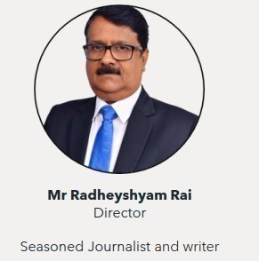
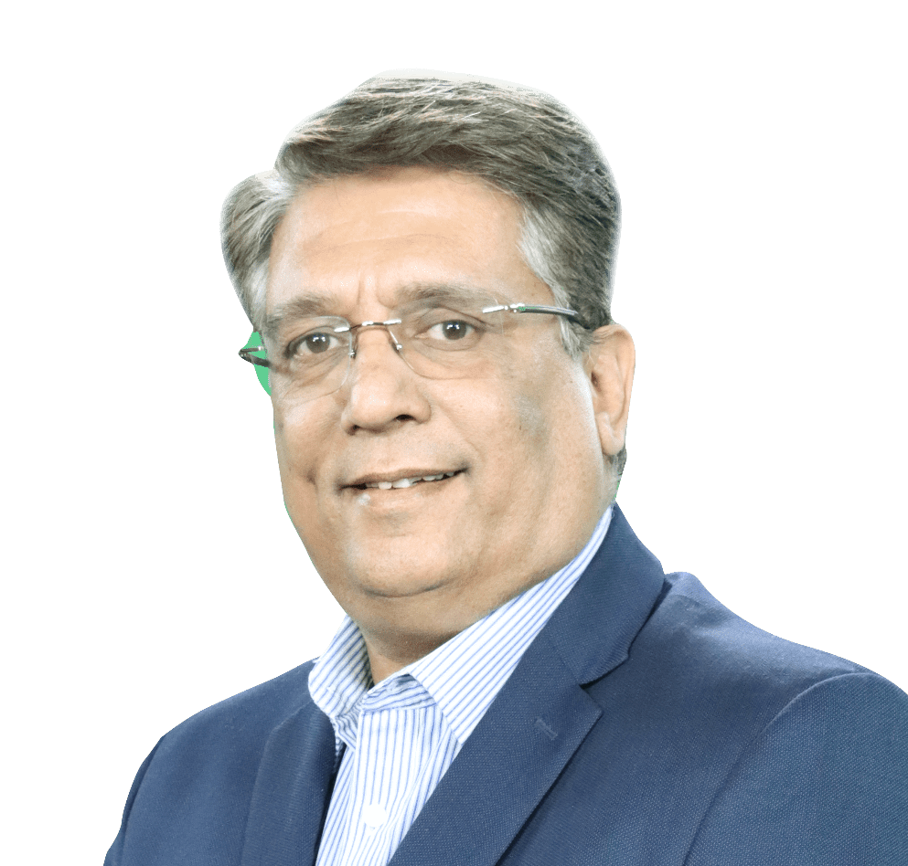
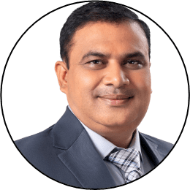
Core Team - The News Leaders!
Mr Radheyshyam Rai
Director & Group Managing Editor
Seasoned Journalist and writer
Mr. Varun Kohli
Director & Group CEO
Mr Sudesh Tiwari
Executive Director & Group Editor
Former Media Advisor at NYKS, Ministry of Youth Affairs & Sports
Worked as a member of National Media Core Group chaired by DG, PIB for celebration of 150th anniversary of India’s first war of independence
Former Editor of News Channels – National Voice, TV24, News World India and Sahara Samay NHR
Leadership Experience of 28 years and is known for sustainable business development, understanding of P&L, operations and management strategies.
Former CEO, iTV Network is known as the Turn Around Specialist in Broadcast & Print Media. Turned India News, NewsX and iBN7 profitable.
Varun Amplified revenue of Amar Ujala with strategic roadmap and detailed benchmarking
Senior Journalist with over 25 years of experience started his career as a correspondent with ‘Chautha Sansaar’ Hindi daily. He worked as Editor (Western Madhya Pradesh) for Voice of India and Sahara Samay MPCG. At Sahara Samay MP-CG he was entrusted with responsibilities of Editor/Channel Head looking after the overall responsibilities of the news channel.
Along with news planning and presentation he is known for his expertise in revenues generation for the news business.

Slide 5
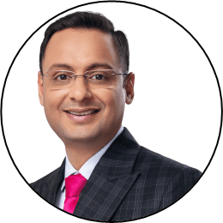
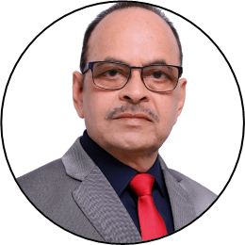
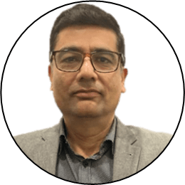
Core Team - The News Leaders!
Mr Hemant Ghai
News Director, Business
Mr Manoj Tomar
Executive Director & Group Editor
Mr Rakesh Gopal
CRO
Founder member of the team that launched India’s No 1 Hindi Business News Channel “CNBC AWAAZ”
Worked in Leadership position from June 2004 until Jan 2021 with CNBC AWAAZ
Contributed towards investor awareness and deepening of stock markets. Hosted various investor awareness conferences across India
Hemant will be instrumental in network's initiatives in Business News Space
Seasoned Journalist with over 30 years of continuous active journalism experience.
Former Bureau Chief in National Daily Rashtriya Sahara, Tomar quickly rose to be the Resident Editor of Lucknow, Gorakhpur, Varanasi and then Group Editor in Delhi.
Mr. Tomar, who has expertise in news planning, is known as an interview specialist. He has specialization in political, social, health and religious issues.
Seasoned media professional with more than 25 years experience of heading Multi-Media sales function across Print, Digital, TV and Radio
Skilled in Marketing Management, Analytical Skills, Advertising, Sales, and Customer Relationship Management (CRM)
Handled revenue size wrth INR 200 cr for Rajasthan Patrika group, INR 150 cr+ for iTV Network

Slide 6















Bringing NEWS Back!
Presenting News as-it-is
Unbiased News, Not Opinions, Without Taking Sides.
Differentiated Content!
Setting up Special Investigative Team
  Bringing Investigative Journalism back
Snackable News Content
  Shorter News Wheels for seamless TV & Digital integration
  Dedicated Content across popular genres like Cricket, Crime, Astro, Health, Wealth, Auto, Tech and Entertainment
Popular Prime Time Debates
  News that directly impacts people
Creating a Complete News Experience
  Discerning News Viewers of today don't just want information but a complete news experience that is intellectual and emotionally engaging
  A 360⁰ perspective to news stories
  Mega Shows, Big-Ticket Interviews, Ground-Zero Reporting

Slide 7
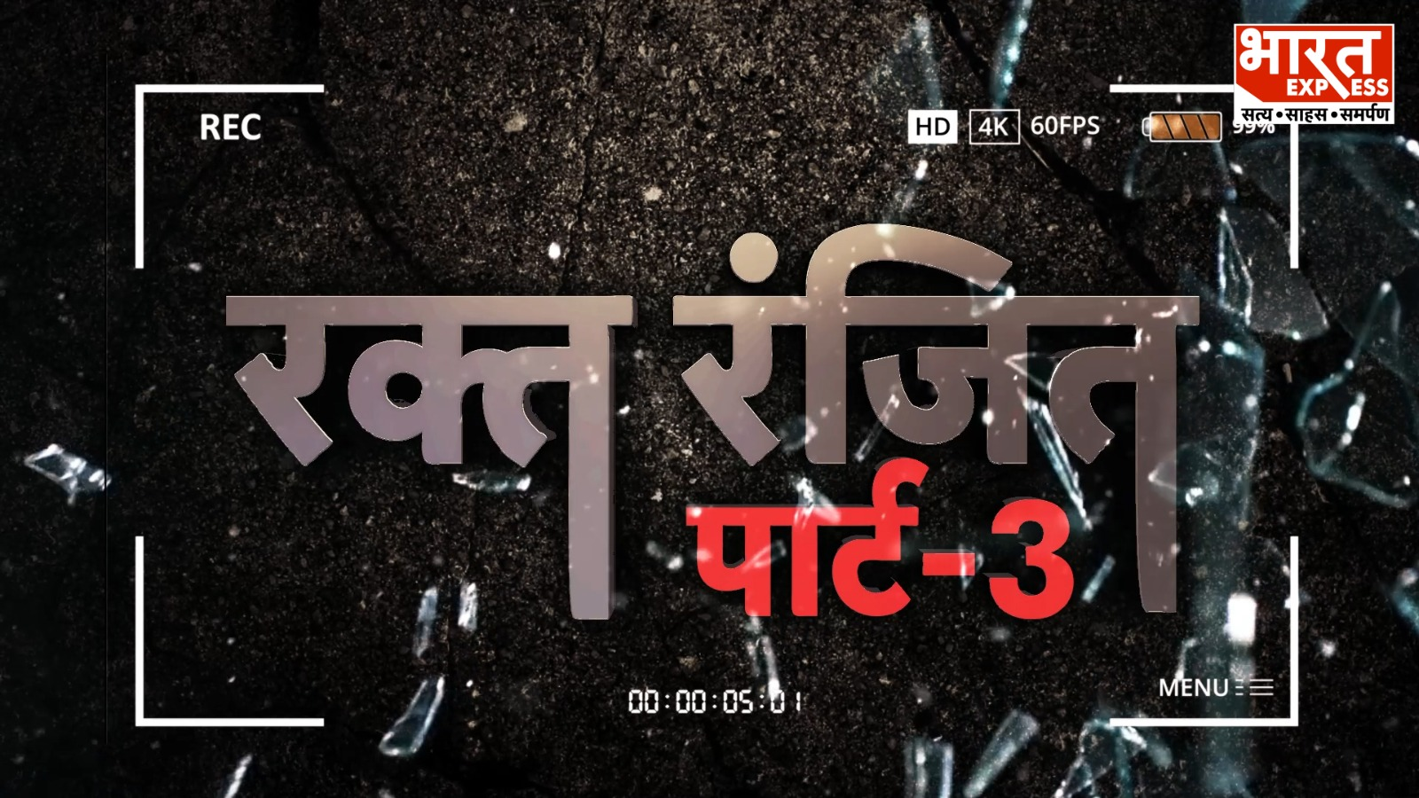
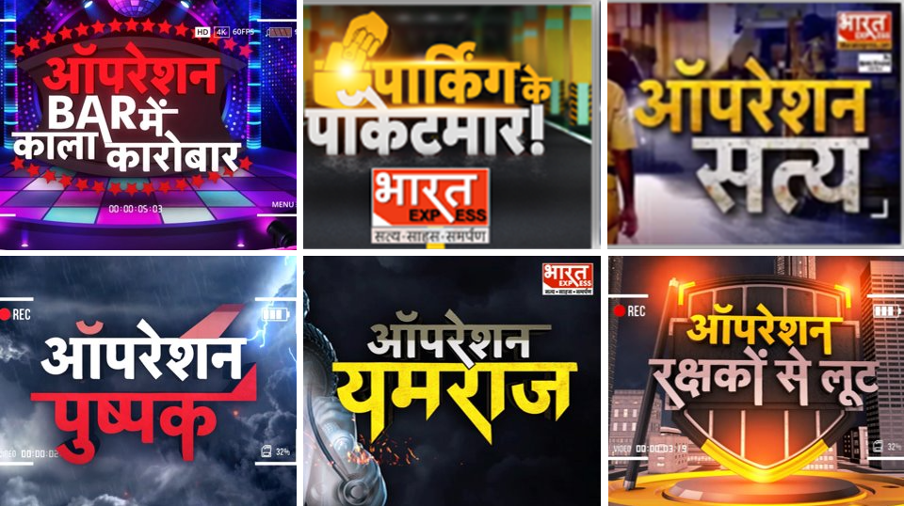
Impact Journalism!
The channel has even set-up a Special Investigative Team to bring investigative journalism back and has recently launched sting operations in public interest to become the Real Voice of the Nation that truly reflects the issues of the people -
  #OperationRaqtRanjit exposing the illegally operating slaughterhouses disturbing religious harmony
  #BarMeinKalaKarobar exposing the illegal dance bars operating in Delhi
  #OperationParkingKePocketmaar exposing the illegal Parking in Delhi NCR region
  #OperationSatya exposed corruption in Delhi Police by revealing wrongful job allocation on reserved seats
  #OperationPushpak exposed corruption in the DGCA
  #OperationYamraj exposed medical and insurance fraud that is going among leading private hospitals
  Investigative stories exposing the land scam in the Osho Ashram, Worsening Conditions of Jails in UP and Expose on Government hospitals using common syringe for children in districts of UP generated swift action from Government

Slide 8
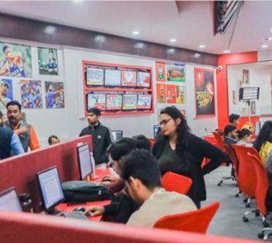
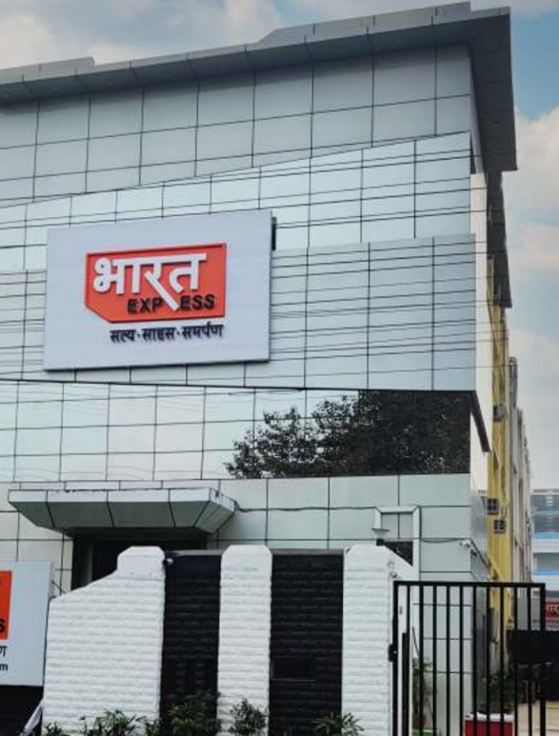
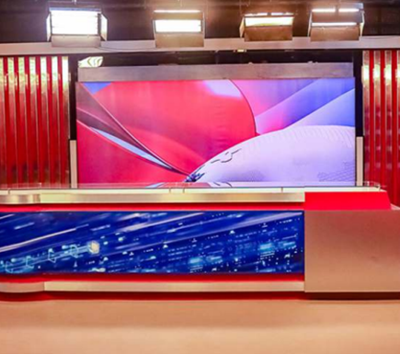
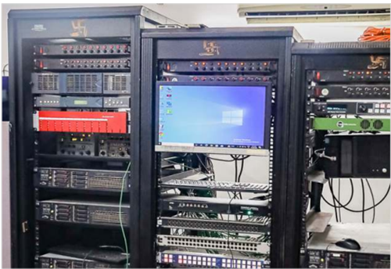
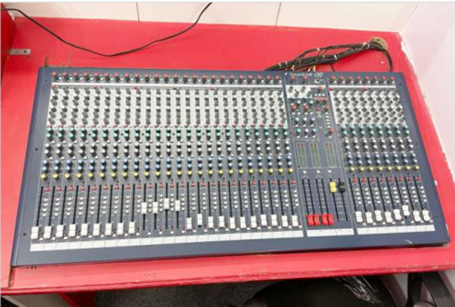
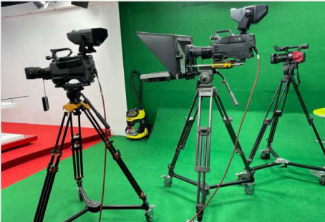
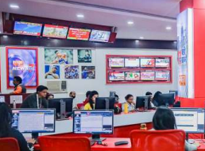
State-of-the-Art Infrastructure
Over 50,000 sq feet of Office Space including News Studios, Croma Sets, Newsrooms, Cameras and Latest Broadcast Technology

Slide 9

Biggest Launch Campaign of a News Channel!
60,000+ OUTDOOR HOARDINGS ACROSS INDIA
FULL PAGE FRONT JACKET ADS -
  HINDUSTAN TIMES
  HINDUSTAN HINDI
  DAINIK JAGRAN
  HALF PAGE AD IN TIMES OF INDIA
DIGITAL CAMPAIGN ON HT, LIVE MINT, LIVE HINDUSTAN WEBSITES

Slide 10
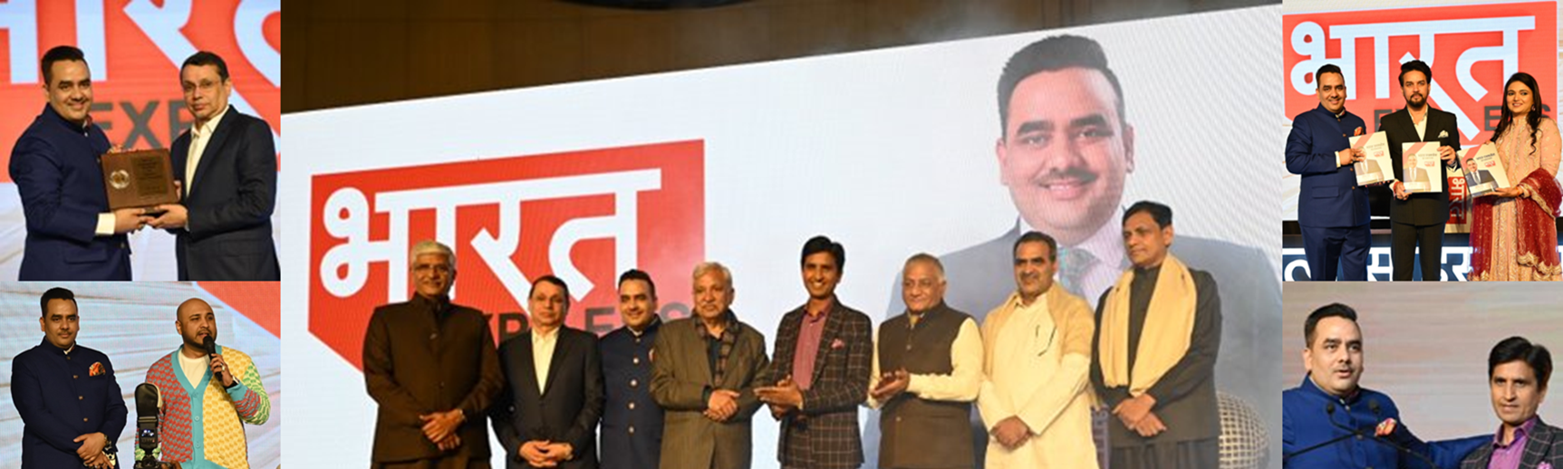
GRAND LAUNCH PARTY
Launched by Mr Uday Shankar in a Grand Ceremony on 1st February 2023 in presence of approximately 3000 esteemed guests including senior Political Leaders, Bollywood Celebrities, Sports Icons and Business Luminaries namely Shri Anurag Thakur, Minister for I&B and Youth Affairs & Sports, Shri Gajendra Singh Shekhawat, Minister of Jal Shakti, Mr Nityanand Rai, MoS, Home Affairs, Shri Sanjeev Balyan, MoS, Fisheries, Animal Husbandry and Dairying, Mr Sunil Arora, Former Chief Election Commissioner of India and Dr Kumar Vishwas. Bollywood Singer B Praak also dazzled the audience with his impromptu performance.

Slide 11
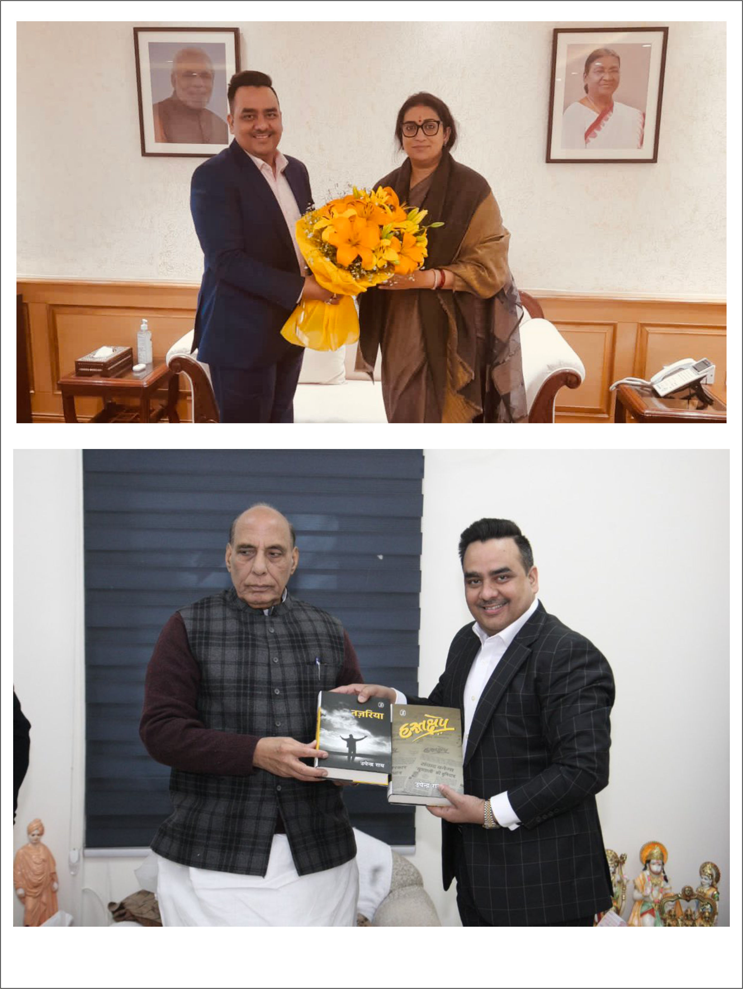
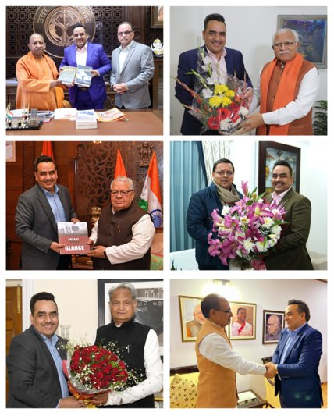
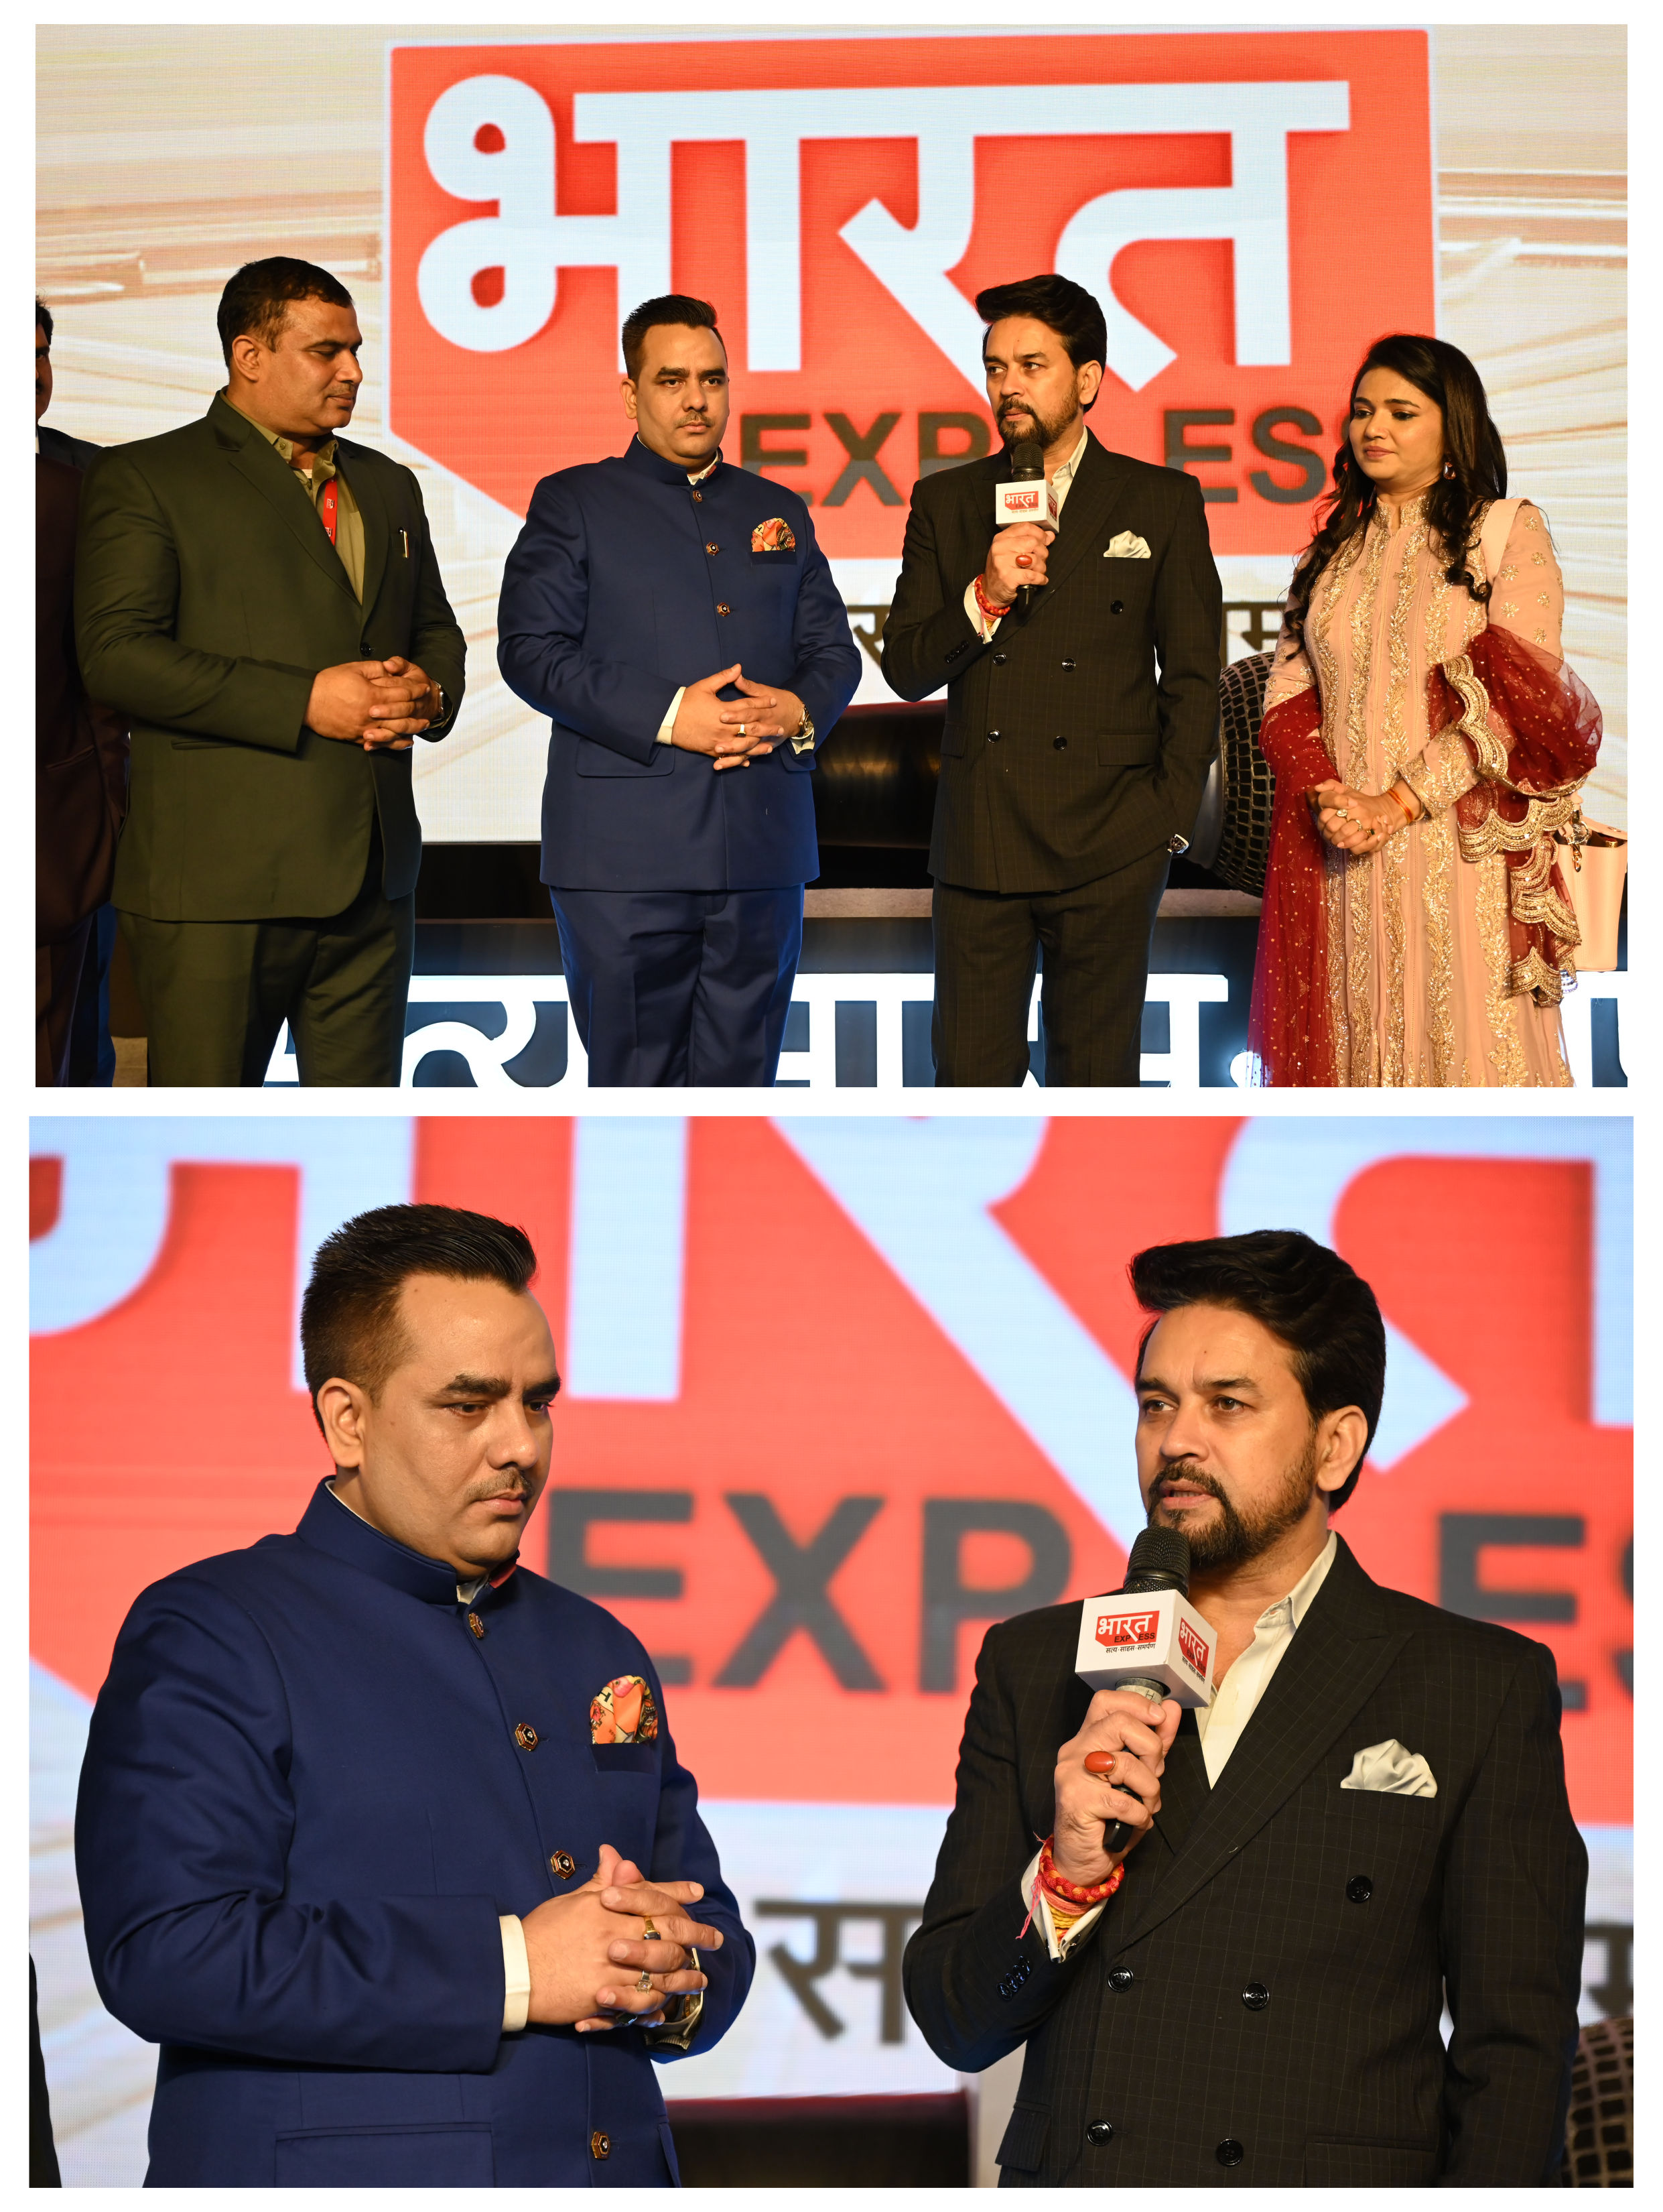
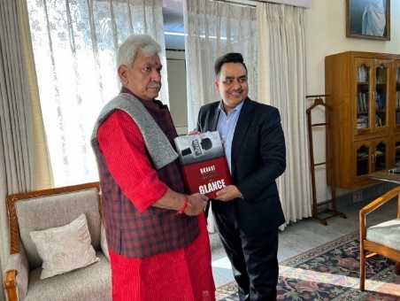
Well wishes from Union Ministers, Chief Ministers and Senior Political Leaders for the Launch!

Slide 12
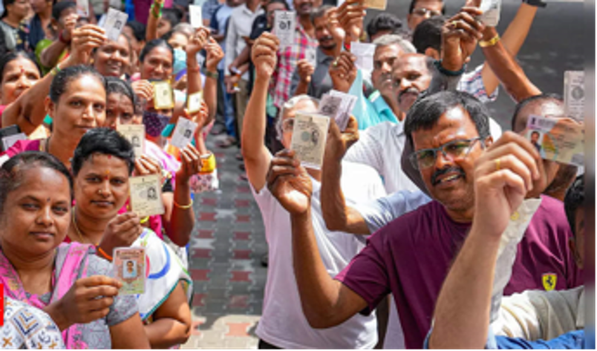

Election Coverage on Bharat Express

Slide 13
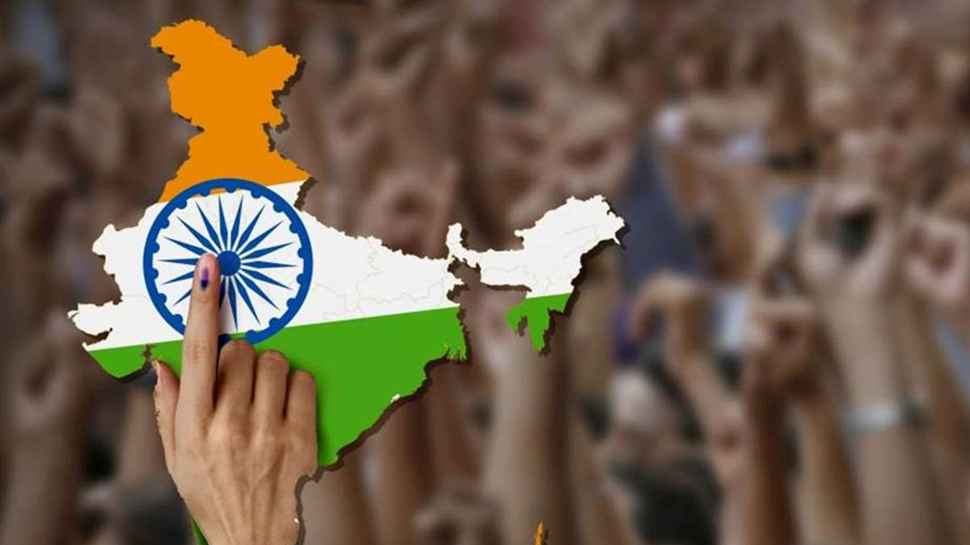

Assembly Elections in the Key States of Rajasthan, MP & Chhattisgarh, have set the stage for the General Elections in 2024

Slide 14

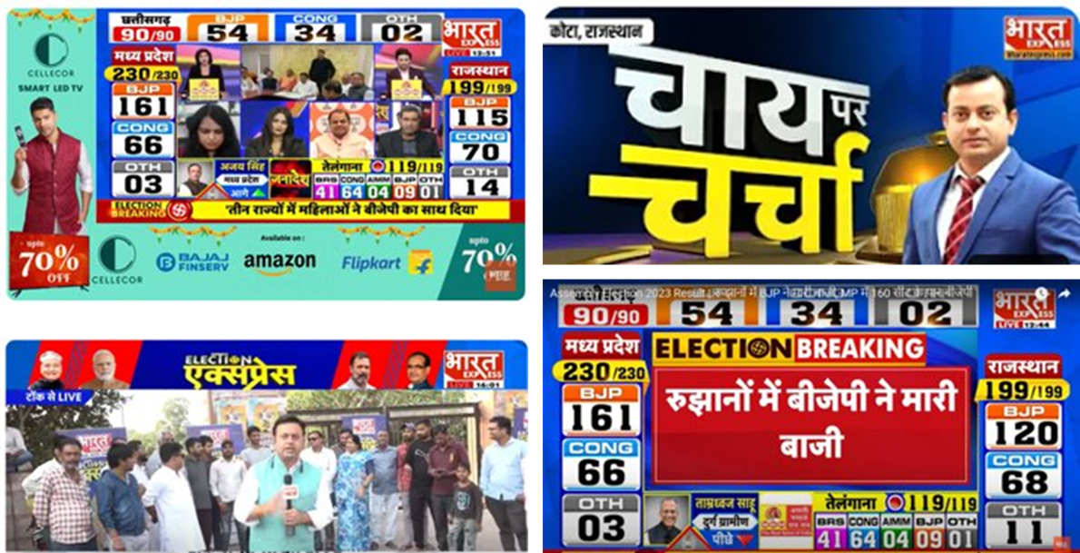
Bharat Express launched a Mega Coverage of the Elections
On-Ground Reports
Vox-Pops
Prime-time Debates
Road Shows through Branded Cab
Exit Polls
Comprehensive Coverage of Polling Days
Continuous Coverage on Counting Day

Slide 15
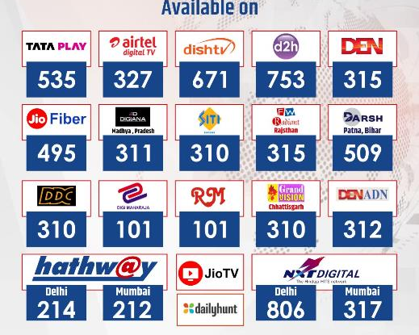

Channel Distribution
Pan India Presence on Leading DTH, MSO's & Local Cable Networks

Slide 16







Thanks to all the Partners for choosing us!

Slide 17

Let's Join Hands!

